Slide 1
Paydirt: Valuing and utilizing sediments
Brandon Kelly
Mentored by dr. Jordon buckler
Florida Atlantic university REU on Renewable Energy
Summer 2022
Notes:
When I was growing up in Southwestern Pennsylvania, I was fascinated to learn that my family didn’t really own the land my house was built on.

Slide 2
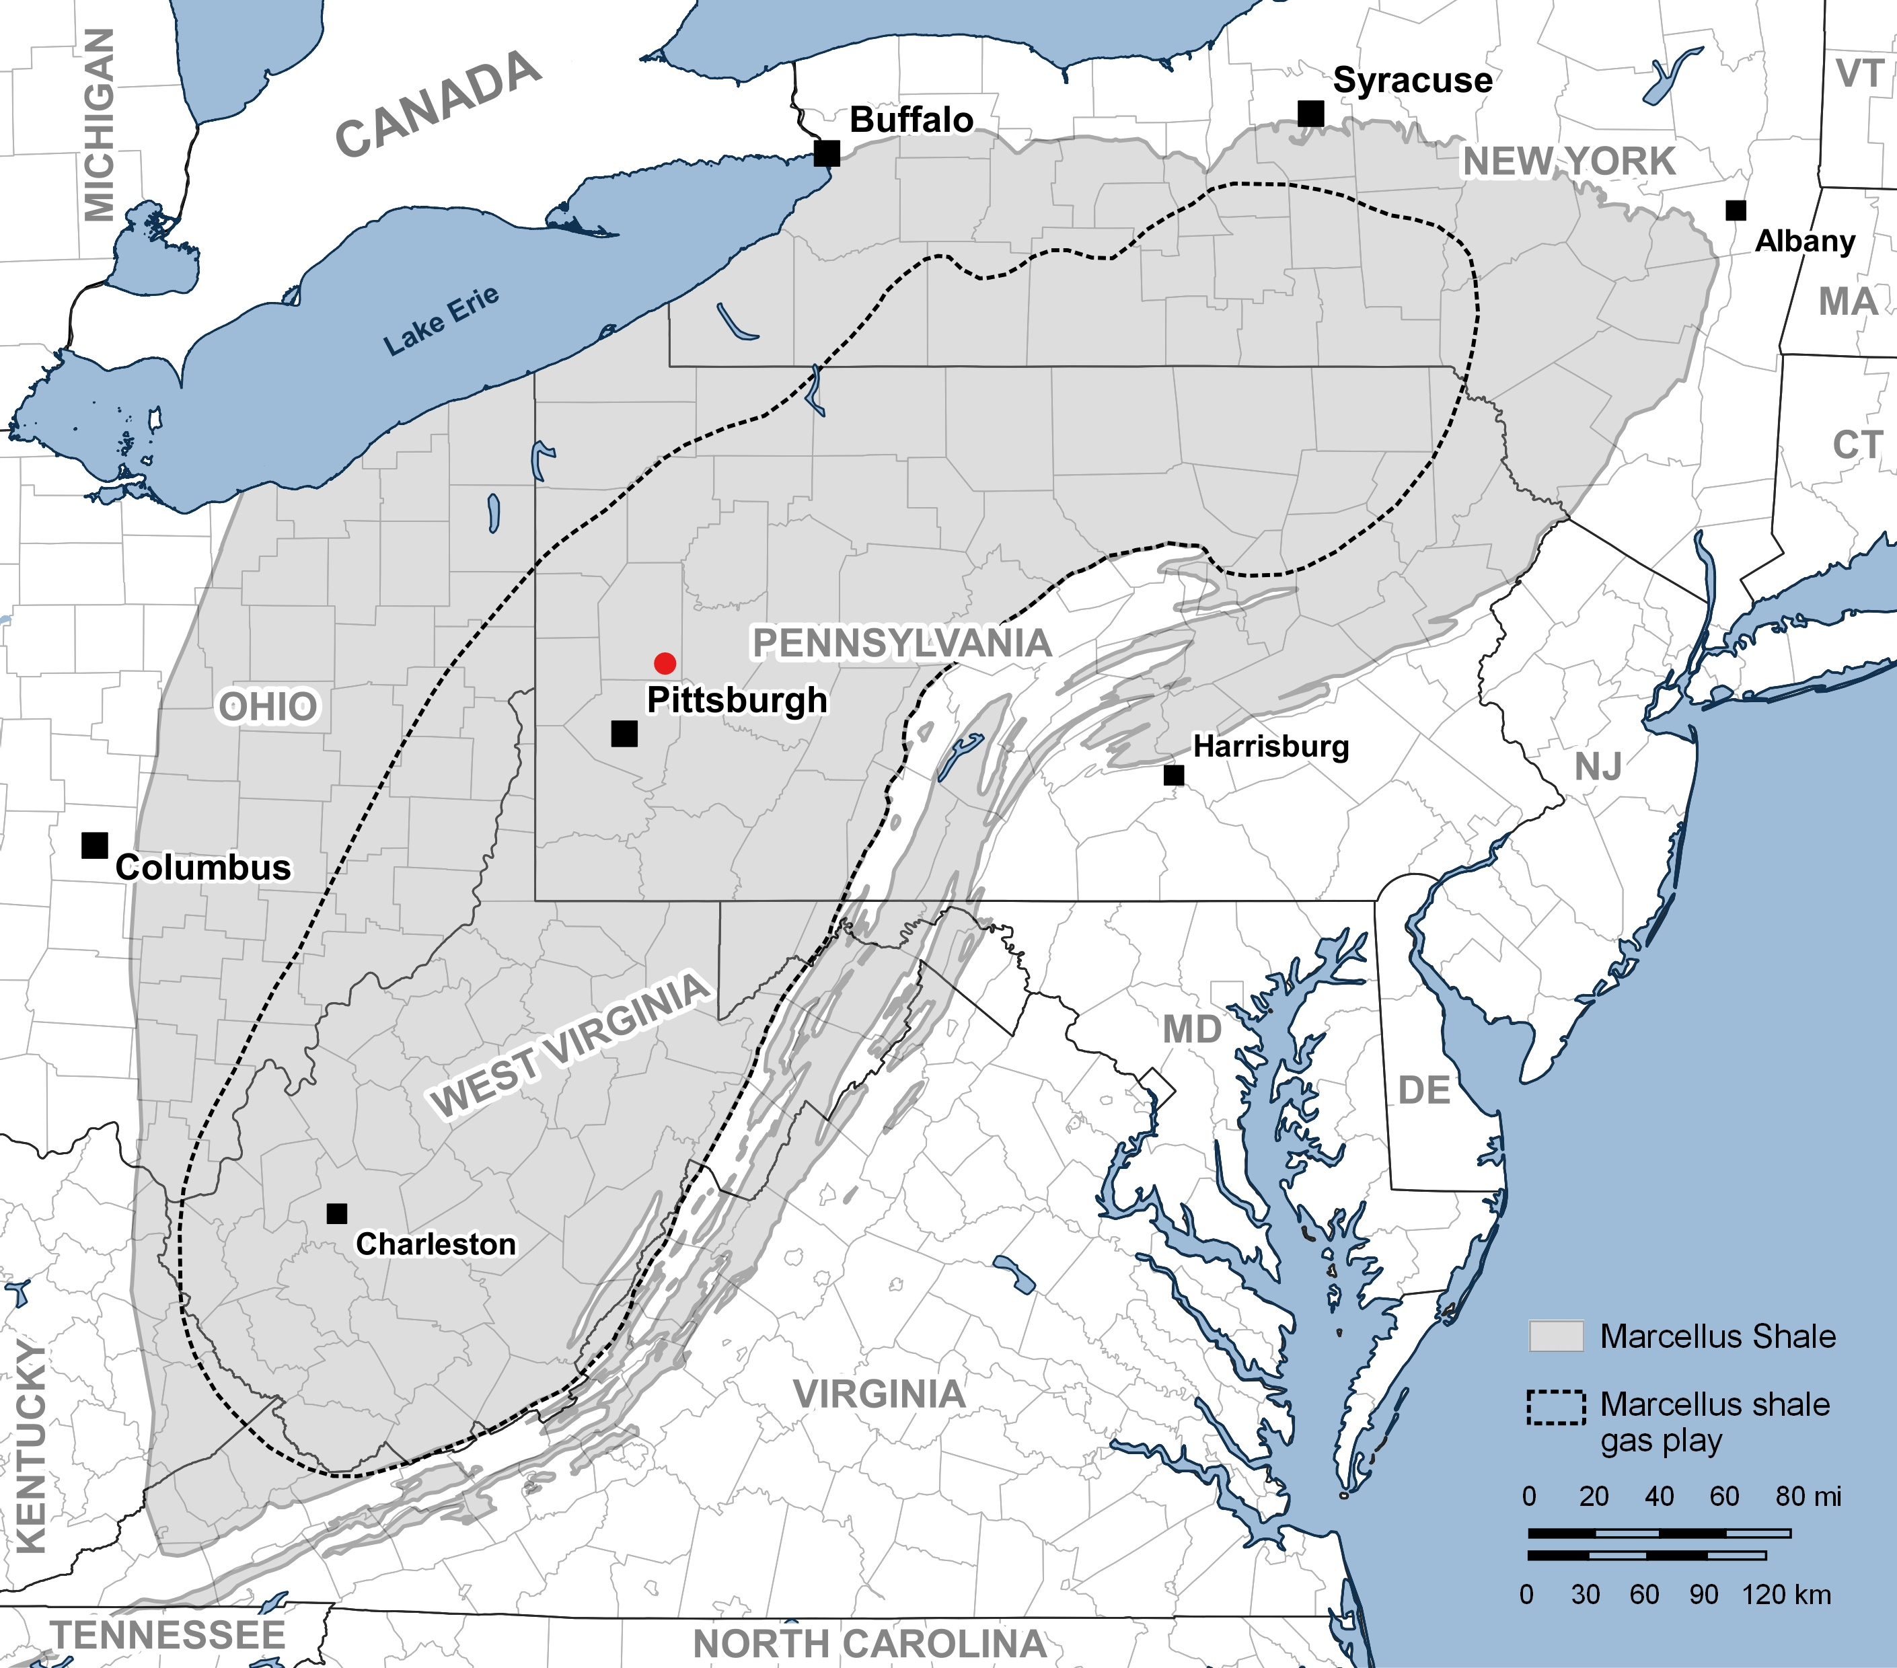
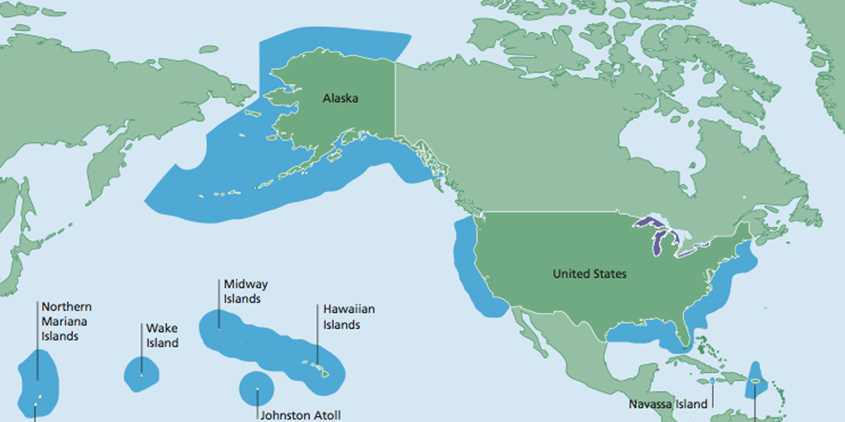
Valuing resources
Valuing land resources
Valuing marine* resources
*(& Freshwater)
?
Notes:
More correctly, we didn’t own the mineral rights and being in shale and coal country there was quite a bit value tied up in those rights. This value was primarily based on the power it could produce.

Slide 3
How do you value dirt?
Much Simpler on the Surface
3D Property
“Stacked Usage”
Focus on the Benthic Layer
Hard Resources to Quantify
Oil is Easy, Dirt is Hard
Tie it to Energy
Notes:
On land, this relatively easy, most land in the US is owned by people or corporations and can be assigned value in a typical supply and demand way, or the land has a known value based on the resource present such as lumber, water, or even wind
For Marine and Freshwater areas, this is less simple. Most of these are territorial waters but beyond complicated ownership and usage rights, there are far more fundamental problems For one the ocean is significantly more three dimensional than the surface in that you can have on land, to avoid the complications of these fact, we will focus exclusively on the benthic layer.
Another issues is that it is simply hard to say how much this value is worth. While oil is already priced by barrel, we don’t have a similar measure for underwater sediments. A good initial method to value these sedimentary resources is to tie them to the energy production, which is indicative of the microbial activity in the area.

Slide 4
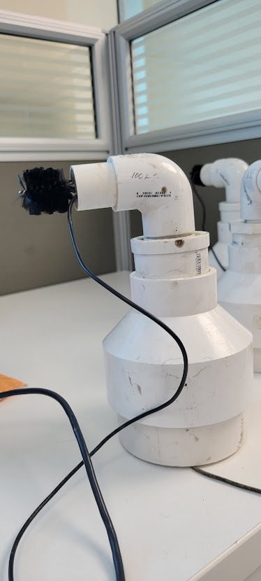
Value of “dirty” energy
Benthic Microbial Fuel Cells:
Generates Electricity Using Microbes and Nutrients in Sediment
Allows us to Monitor Sediments Long-Term
Can Power Remote Sensor Network
Detect Problems, Such as Algal Blooms
Normalize Power Production by Footprint Area
Can Control Placement Density to Control Resolution
Notes:
One of the major ways we can assess value to sediments is based on their potential for Energy Production. Benthic Microbial Fuel Cells give us a tool to quantify these metrics. The fuel cells have two major ways they contribute to this effort. 1. Monitoring the Sediments and Surrounding environment for health, nutrient changes, and other factors(including ones separate from sediment such as algal blooms which can help prevent or mitigate the effects) and two they can actually gives the power production per unit area. By changing the placement density, we can change the resolution to either cover large swathes of the sea or get detailed mapping of areas of interest.

Slide 5
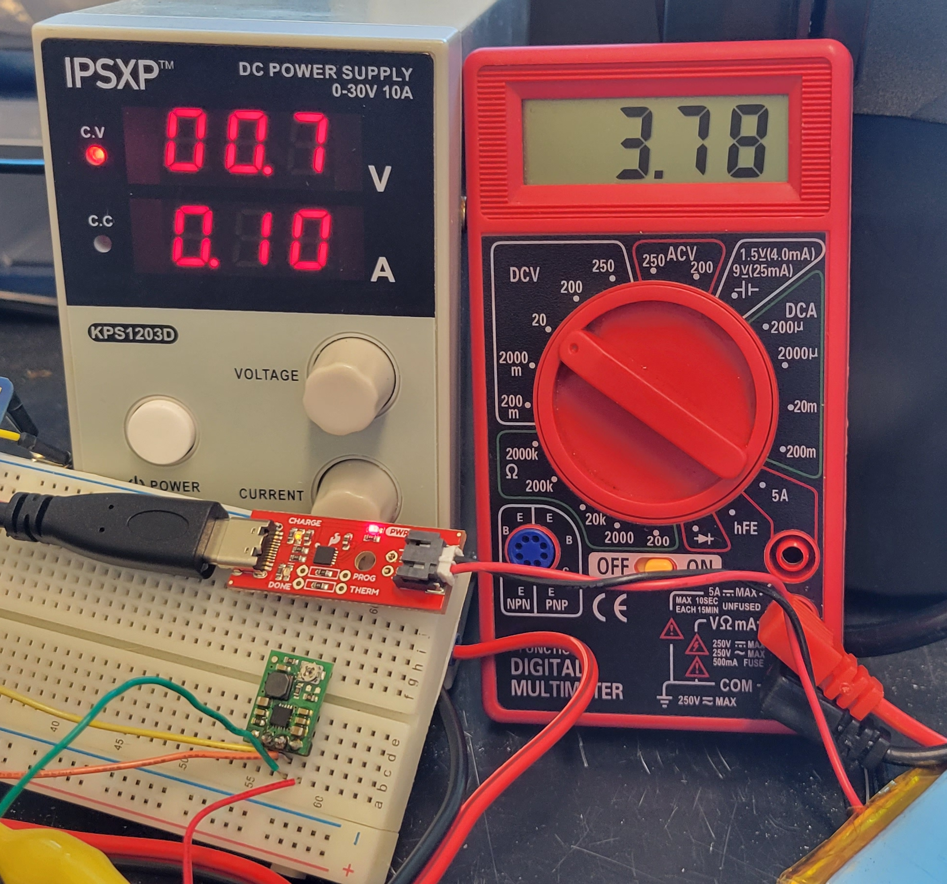
Harvesting Power
Low Voltage
Step Up Converter: “Trades” Current for Voltage
Low Power
High Efficiency, Low “Quiescent Current”
Output Agnostic
Delivers Power No Matter Destination
Notes:
My research this summer has been primarily focused on taking this fuel cells and using them to power sensors and other equipment in the benthic zone, that is the bottom layer of a water system. There are several primary concerns that I had to design for. Most sensors need to be powered at significantly higher voltage than the fuel cells natively produce. DC-DC converter talk. We also have to deal with low power production, thus efficient electronics. We also want the power to be output agnostic, meaning that we don’t want the power system to require communication from the sensor package

Slide 6
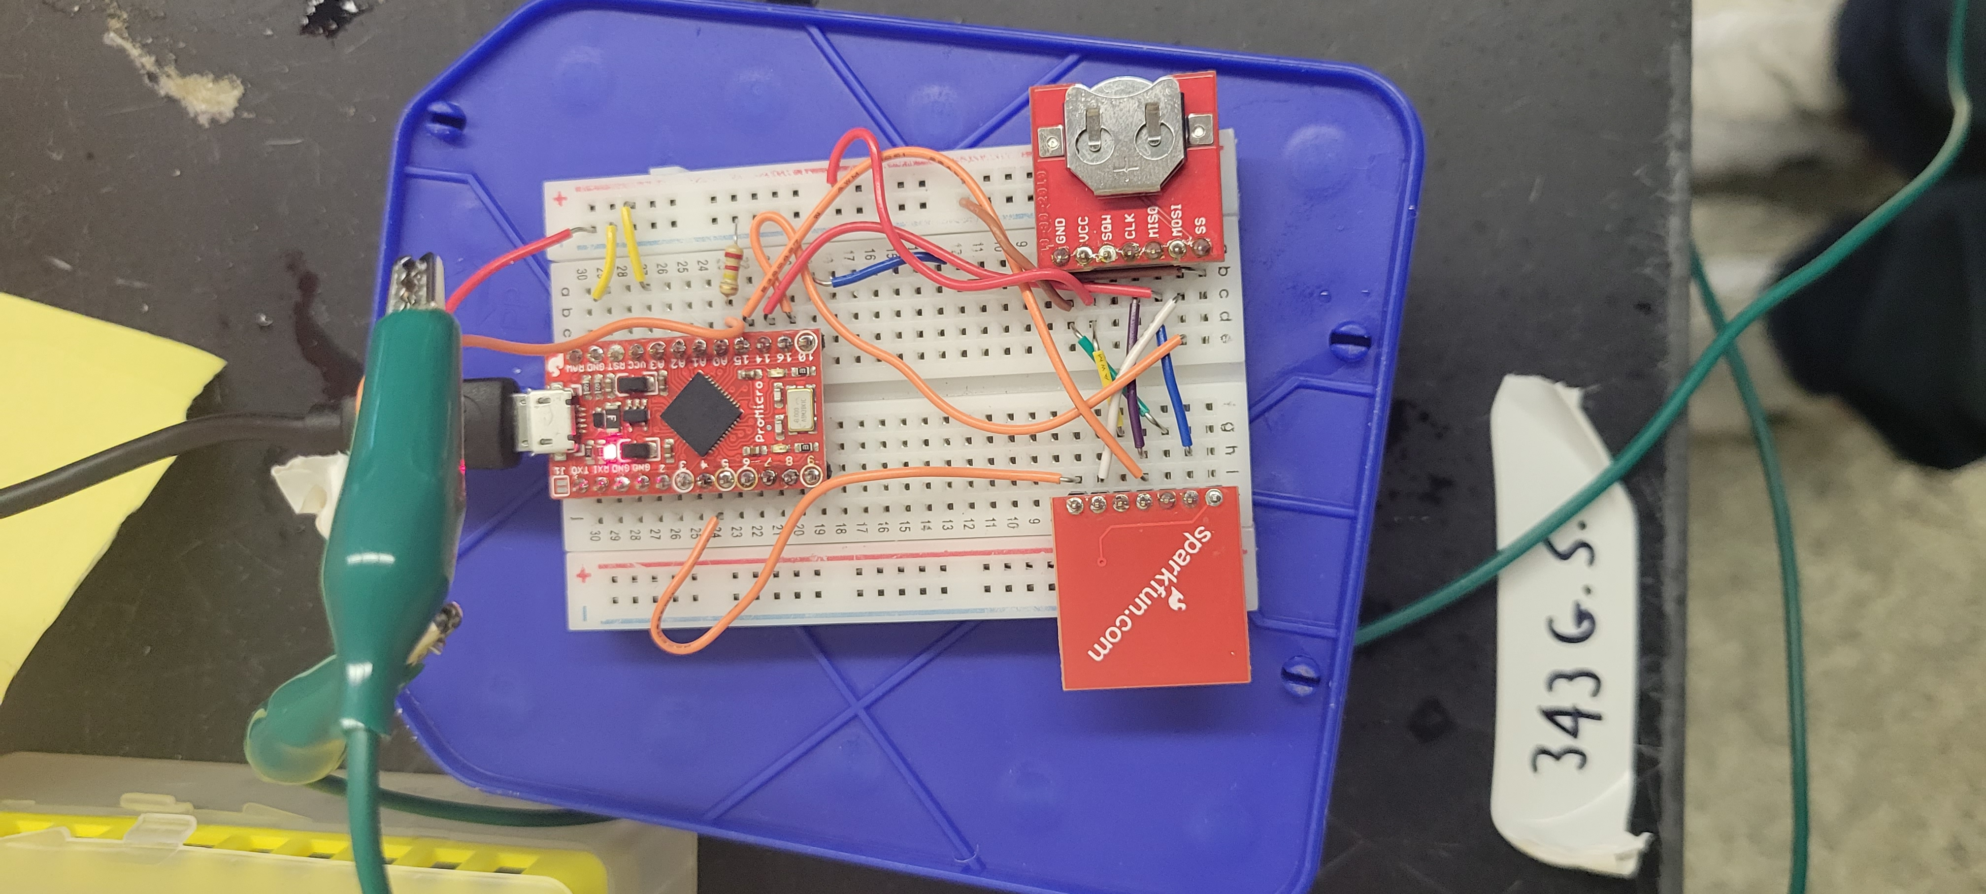
Capturing data
Tracks Voltage of Fuel Cell
Measures Fuel Cell Performance over time
Modular Electronics
Easily Add Thermometer, Ph, Salinity Meters
Designed for Conversion to In Situ Deployment
Low Power Board Chosen
Code has Optimizations
Notes:
Another somewhat parallel development I worked on. This is a possible sensor package for the fuel cell. It allows to collect timestamped voltage data to measure the fuel cells performance overtime. Since it is based on Arduino it is incredibly simple to add a temperature monitoring with simple electronic components or a ph/salinity meter with a little more work. Also put in effort to quickly reconfigure this from lab setting to be able to go into the field

Slide 7
Performance of fuel cells
 | Arc Reactor | Battery 1 | Battery 2 | Lit. Value
O.C.V
Max Power
V_{maxPower}
Power Battery
Ohmic Reistance

Slide 8
Questions?

